Slide 1


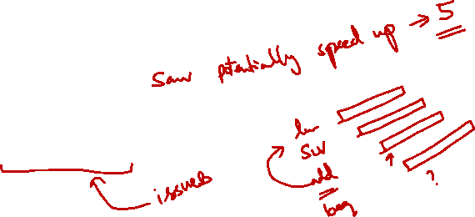
http://www.comp.nus.edu.sg/~cs2100/
Lecture #21
Pipelining
Part II: Hazards

Slide 2

Lecture #21: Pipelining II
Pipeline Hazards
Structural Hazards
Instruction Dependencies
Data Hazards
4.1 Forwarding
4.2 Stall
4.3 Exercises

Slide 3
Lecture #21: Pipelining II
Control Dependency
Control Hazards
6.1 Early Branch
6.2 Branch Prediction
6.3 Delayed Branched
Multiple Issue Processors (reading)

Slide 4
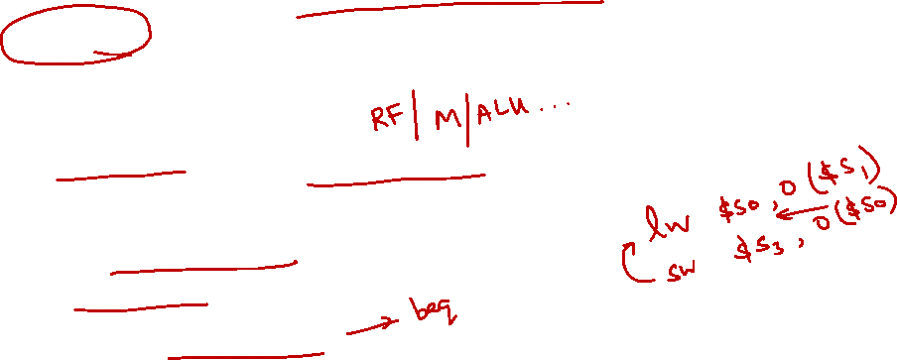
1. Pipeline Hazards
Speedup from pipeline implementation:
Based on the assumption that a new instructions can be "pumped" into pipeline every cycle
However, there are pipeline hazards
Problems that prevent next instruction from immediately following previous instruction
Structural hazards:
Simultaneous use of a hardware resource
Data hazards:
Data dependencies between instructions
Control hazards:
Change in program flow
Instruction Dependencies

Slide 5
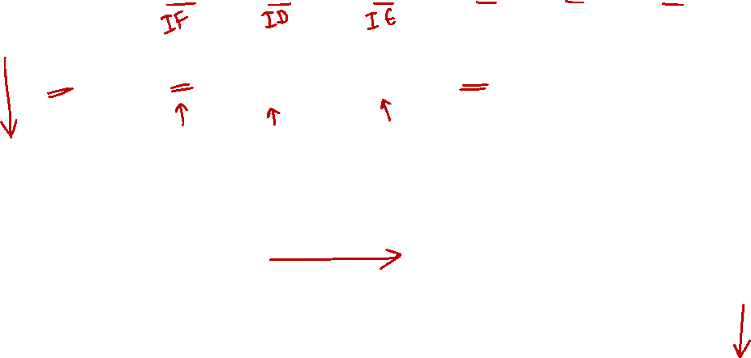
1. Graphical Notation for Pipeline
IM: Instruction Memory
DM: Data Memory
Horizontal = the stages of an instruction
Vertical = the instructions in different pipeline stages

Slide 6
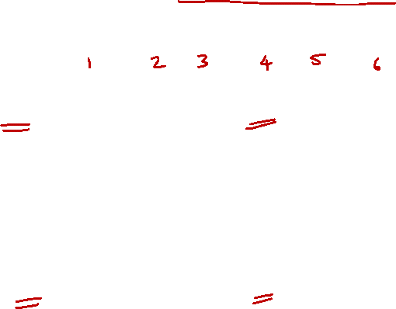
2. Structural Hazard: Example
If there is only a single memory module:
Time (clock cycles)
Load and Inst3 access memory in the same cycle!
Load
Mem
Reg
ALU
Mem
Reg
Inst1
Mem
Reg
ALU
Mem
Reg
Instruction Order
Inst2
Mem
Reg
ALU
Mem
Reg
Inst3
Mem
Reg
ALU
Mem
Reg

Slide 7
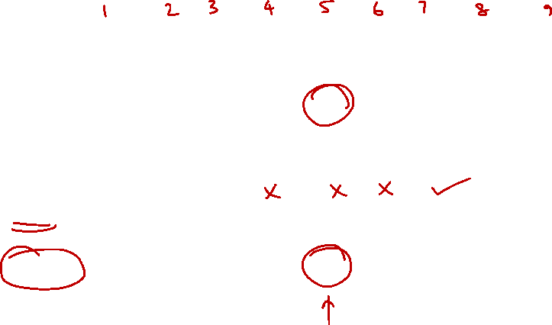
2. Solution 1: Stall the Pipeline
Time (clock cycles)
Load
Mem
Reg
ALU
Mem
Reg
Inst1
Mem
Reg
ALU
Mem
Reg
Inst2
Mem
Reg
ALU
Mem
Reg
Instruction Order
Stall
Bubble
Bubble
Bubble
Bubble
Bubble
Inst3
Delay (Stall) Inst3 for
1 cycle
Mem
Reg
ALU
Mem
Reg

Slide 8
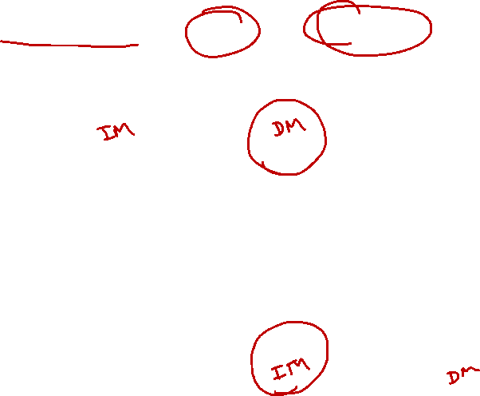
2. Solution 2: Separate Memory
Split memory into Data and Instruction memory
Time (clock cycles)
Load uses Data Memory
Load
Mem
Reg
ALU
Mem
Reg
Inst1
Mem
Reg
ALU
Mem
Reg
Instruction Order
Inst2
Mem
Reg
ALU
Mem
Reg
Inst3
Mem
Reg
ALU
Mem
Reg
Inst3 uses Instr. Memory

Slide 9
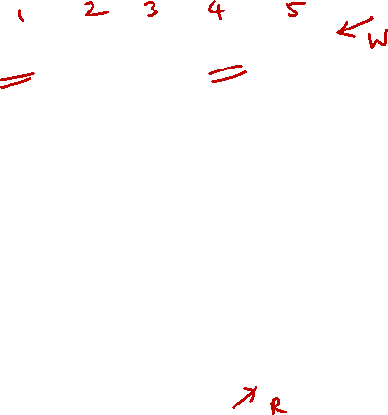
2. Quiz (1/2)
Is there another conflict?
Time (clock cycles)
Inst0 and Inst3 are accessing the Register File in the same cycle. What if both access the same register?
Inst0
Mem
Reg
ALU
Mem
Reg
Inst1
Mem
Reg
ALU
Mem
Reg
Instruction Order
Inst2
Mem
Reg
ALU
Mem
Reg
Inst3
Mem
Reg
ALU
Mem
Reg

Slide 10
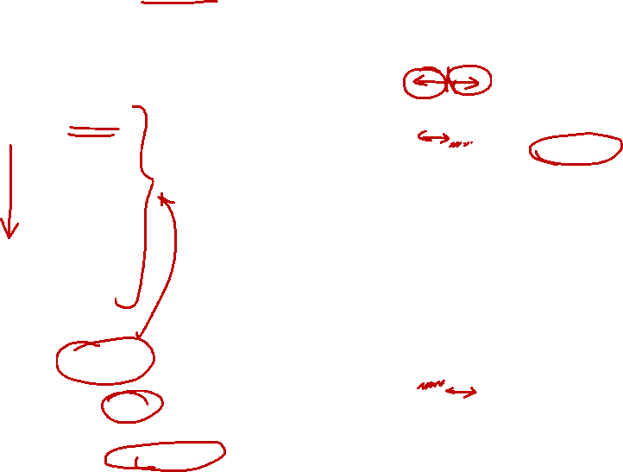
2. Quiz (2/2)
Recall that registers are very fast memory.
Solution: Split cycle into half; first half for writing into a register; second half for reading from a register.
Time (clock cycles)
Inst0 writes into the register during the first half of the cycle.
Inst0
Mem
Reg
ALU
Mem
Reg
Inst1
Mem
Reg
ALU
Mem
Reg
Instruction Order
Inst2
Mem
Reg
ALU
Mem
Reg
Inst3
Mem
Reg
ALU
Mem
Reg
Inst3 reads from the register during the second half of the cycle.

Slide 11
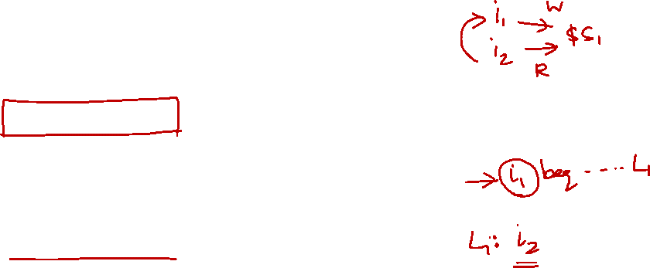
3. Instruction Dependencies
Instructions can have relationship that prevent pipeline execution:
Although a partial overlap maybe possible in some cases
When different instructions accesses (read/write) the same register
Register contention is the cause of dependency
Known as data dependency
When the execution of an instruction depends on another instruction
Control flow is the cause of dependency
Known as control dependency
Failure to handle dependencies can affect program correctness!

Slide 12
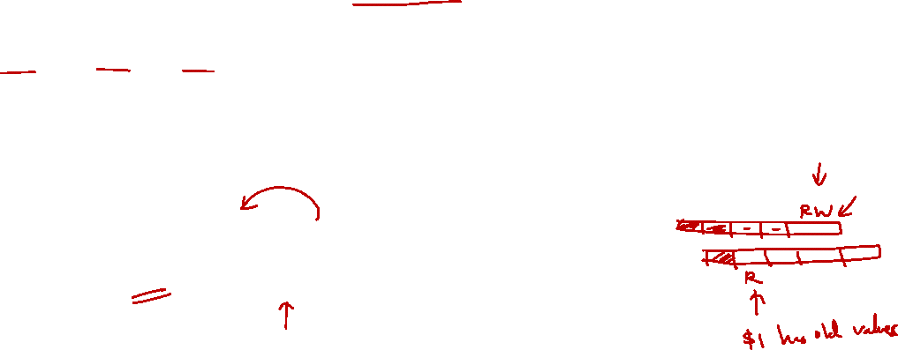
3. Data Dependency: RAW
"Read-After-Write" Definition:
Occurs when a later instruction reads from the destination register written by an earlier instruction
Also known as true data dependency
i1: add $1, $2, $3 #writes to $1
i2: sub $4, $1, $5 #reads from $1
Effect of incorrect execution:
If i2 reads register $1 before i1 can write back the result, i2 will get a stale result (old result)

Slide 13
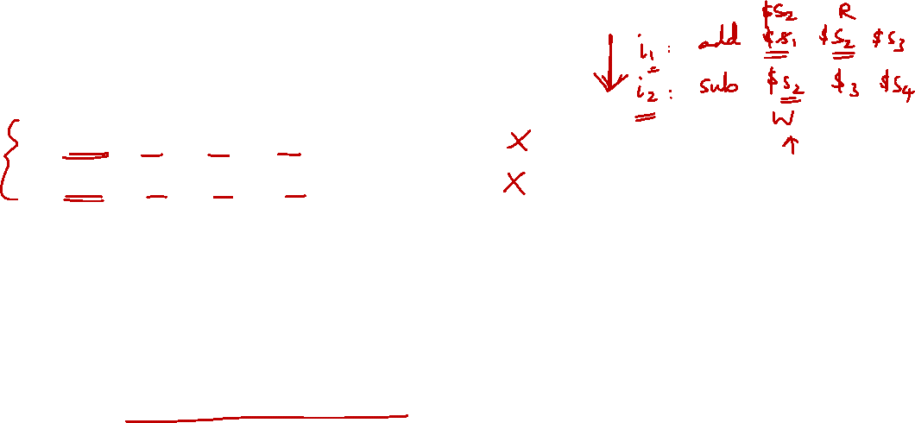
3. Other Data Dependencies
Similarly, we have:
WAR: Write-after-Read dependency
WAW: Write-after-Write dependency
Fortunately, these dependencies do not cause any pipeline hazards
They affect the processor only when instructions are executed out of program order:
i.e. in Modern SuperScalar Processor

Slide 14
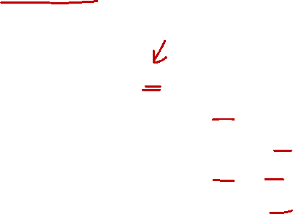
4. RAW Dependency: Hazards?
Suppose we are executing the following code fragment:
sub $2, $1, $3 #i1
and $12, $2, $5 #i2
or $13, $6, $2 #i3
add $14, $2, $2 #i4
sw $15, 100($2) #i5
Note the multiple uses of register $2
Question:
Which are the instructions require special handling?

Slide 15
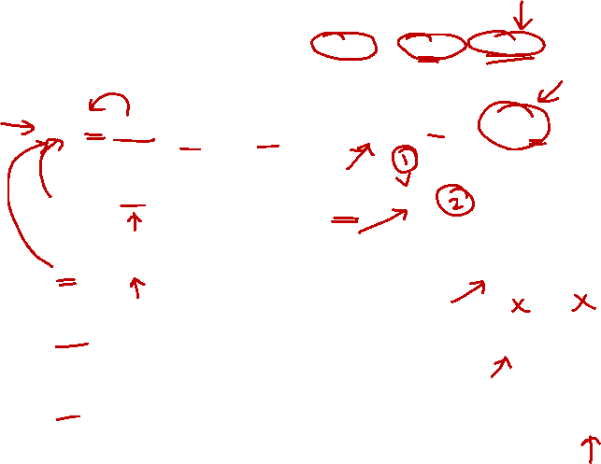
4. RAW Data Hazards
Value from prior instruction is needed before write back
T
i
m
e
(
i
n
c
l
o
c
k
c
y
c
l
e
s
)
V
a
l
u
e
o
f
C
C
1
C
C
2
C
C
3
C
C
4
C
C
5
C
C
6
C
C
7
C
C
8
C
C
9
r
e
g
i
s
t
e
r
$
2
:
1
0
1
0
1
0
1
0
1
0
/
–
2
0
–
2
0
–
2
0
–
2
0
–
2
0
s
u
b
$
2
,
$
1
,
$
3
I
M
R
e
g
D
M
R
e
g
Data
dependency
No problem
a
n
d
$
1
2
,
$
2
,
$
5
I
M
R
e
g
D
M
R
e
g
o
r
$
1
3
,
$
6
,
$
2
I
M
R
e
g
D
M
R
e
g
a
d
d
$
1
4
,
$
2
,
$
2
I
M
R
e
g
D
M
R
e
g
s
w
$
1
5
,
1
0
0
(
$
2
)
I
M
R
e
g
D
M
R
e
g

Slide 16

4. RAW Data Hazards: Observations
Questions:
When is the result from sub instruction actually produced?
End of EX stage for sub or clock cycle 3
When is the data actually needed by and?
Beginning of and’s EX stage or clock cycle 4
When is the data actually needed by or?
Beginning of or’s EX stage or clock cycle 5
Solution:
Forward the result to any trailing (later) instructions before it is reflected in register file
➔ Bypass (replace) the data read from register file

Slide 17
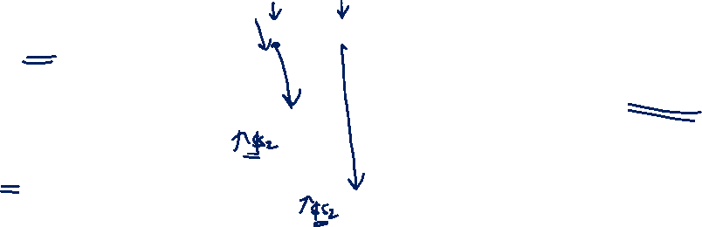
4.1 RAW Data Hazards: Forwarding
T
i
m
e
(
i
n
c
l
o
c
k
c
y
c
l
e
s
)
C
C
1
C
C
2
C
C
3
C
C
4
C
C
5
C
C
6
C
C
7
C
C
8
C
C
9
V
a
l
u
e
o
f
r
e
g
i
s
t
e
r
$
2
:
1
0
1
0
1
0
1
0
1
0
/
–
2
0
–
2
0
–
2
0
–
2
0
–
2
0
V
a
l
u
e
o
f
E
X
/
M
E
M
:
X
X
X
–
2
0
X
X
X
X
X
V
a
l
u
e
o
f
M
E
M
/
W
B
:
X
X
X
X
–
2
0
X
X
X
X
Forward results from one stage to another
Bypass data read from register file
s
u
b
$
2
,
$
1
,
$
3
I
M
R
e
g
D
M
R
e
g
a
n
d
$
1
2
,
$
2
,
$
5
I
M
R
e
g
D
M
R
e
g
o
r
$
1
3
,
$
6
,
$
2
I
M
R
e
g
D
M
R
e
g
a
d
d
$
1
4
,
$
2
,
$
2
I
M
R
e
g
D
M
R
e
g
s
w
$
1
5
,
1
0
0
(
$
2
)
I
M
R
e
g
D
M
R
e
g

Slide 18
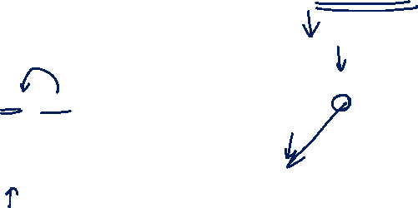
4.2 Data Hazards: LOAD Instruction
T
i
m
e
(
i
n
c
l
o
c
k
c
y
c
l
e
s
)
C
C
1
C
C
2
C
C
3
C
C
4
C
C
5
C
C
6
C
C
7
C
C
8
C
C
9
Cannot solve with forwarding!
Data is needed before it is actually produced!
l
w
$
2
,
2
0
(
$
1
)
I
M
R
e
g
D
M
R
e
g
a
n
d
$
4
,
$
2
,
$
5
I
M
R
e
g
D
M
R
e
g
o
r
$
8
,
$
2
,
$
6
I
M
R
e
g
D
M
R
e
g
a
d
d
$
9
,
$
4
,
$
2
I
M
R
e
g
D
M
R
e
g
s
l
t
$
1
,
$
6
,
$
7
I
M
R
e
g
D
M
R
e
g

Slide 19
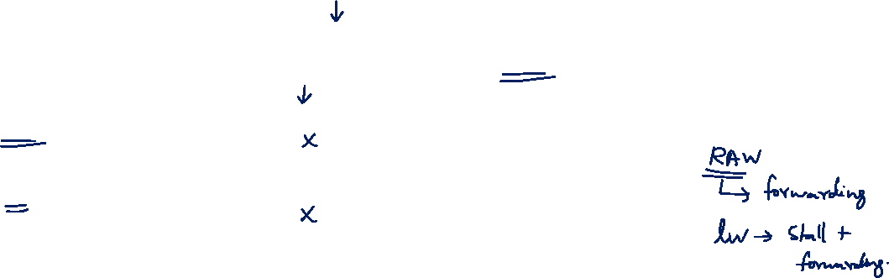
4.2 Data Hazards: LOAD Instruction Solution
P
r
o
g
r
a
m
T
i
m
e
(
i
n
c
l
o
c
k
c
y
c
l
e
s
)
e
x
e
c
u
t
i
o
n
C
C
1
C
C
2
C
C
3
C
C
4
C
C
5
C
C
6
C
C
7
C
C
8
C
C
9
C
C
1
0
o
r
d
e
r
(
i
n
i
n
s
t
r
u
c
t
i
o
n
s
)
Stall the pipeline!
l
w
$
2
,
2
0
(
$
1
)
I
M
R
e
g
D
M
R
e
g
a
n
d
$
4
,
$
2
,
$
5
I
M
R
e
g
Bubble
D
M
R
e
g
o
r
$
8
,
$
2
,
$
6
I
M
Bubble
R
e
g
D
M
R
e
g
a
d
d
$
9
,
$
4
,
$
2
I
M
R
e
g
D
M
R
e
g
s
l
t
$
1
,
$
6
,
$
7
I
M
R
e
g
D
M
R
e
g

Slide 20
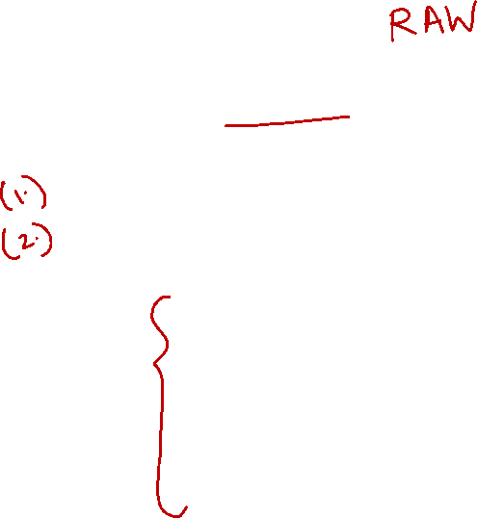
4.3 Exercise #1
How many cycles will it take to execute the following code on a 5-stage pipeline
without forwarding?
with forwarding?
sub $2, $1, $3
and $12, $2, $5
or $13, $6, $2
add $14, $2, $2
sw $15, 100($2)

Slide 21
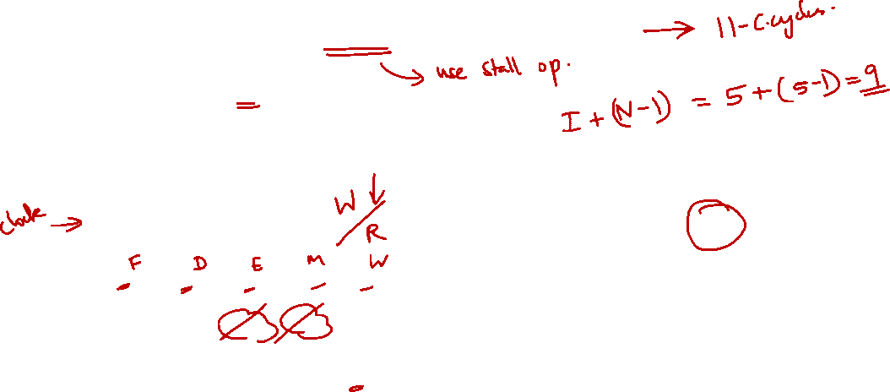
4.3 Exercise #1: Without Forwarding
sub $2, $1, $3
and $12, $2, $5
or $13, $6, $2
add $14, $2, $2
sw $15, 100($2)
1 | 2 | 3 | 4 | 5 | 6 | 7 | 8 | 9 | 10 | 11
IF | ID | EX | MEM | WB
sub
and
IF |  |  | ID | EX | MEM | WB
 |  |  | IF | ID | EX | MEM | WB
 |  |  |  | IF | ID | EX | MEM | WB
 |  |  |  |  | IF | ID | EX | MEM | WB
or
add
sw


Slide 22
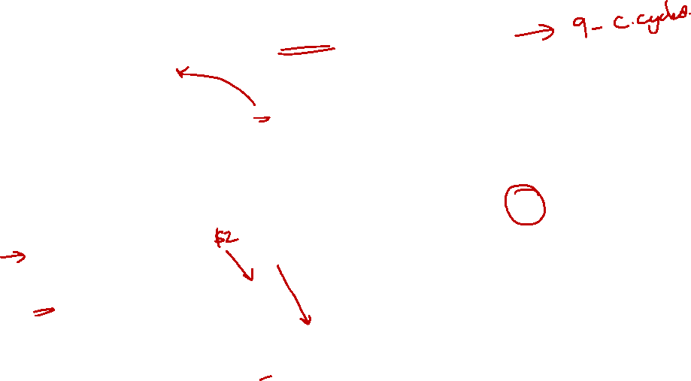
4.3 Exercise #1: With Forwarding
sub $2, $1, $3
and $12, $2, $5
or $13, $6, $2
add $14, $2, $2
sw $15, 100($2)
1 | 2 | 3 | 4 | 5 | 6 | 7 | 8 | 9 | 10 | 11
IF | ID | EX | MEM | WB
sub
and
IF | ID | EX | MEM | WB
 | IF | ID | EX | MEM | WB
 |  | IF | ID | EX | MEM | WB
 |  |  | IF | ID | EX | MEM | WB
or
add
sw


Slide 23

4.3 Exercise #2
How many cycles will it take to execute the following code on a 5-stage pipeline
without forwarding?
with forwarding?
lw $2, 20($3)
and $12, $2, $5
or $13, $6, $2
add $14, $2, $2
sw $15, 100($2)

Slide 24
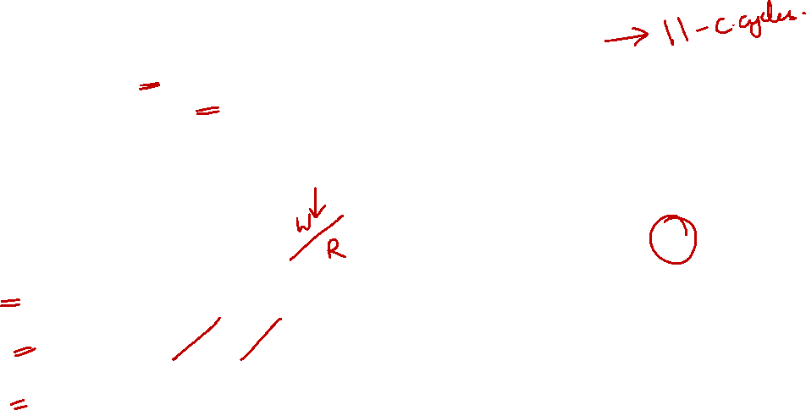
4.3 Exercise #2: Without Forwarding
lw $2, 20($3)
and $12, $2, $5
or $13, $6, $2
add $14, $2, $2
sw $15, 100($2)
1 | 2 | 3 | 4 | 5 | 6 | 7 | 8 | 9 | 10 | 11
IF | ID | EX | MEM | WB
lw
and
IF |  |  | ID | EX | MEM | WB
 |  |  | IF | ID | EX | MEM | WB
 |  |  |  | IF | ID | EX | MEM | WB
 |  |  |  |  | IF | ID | EX | MEM | WB
or
add
sw


Slide 25
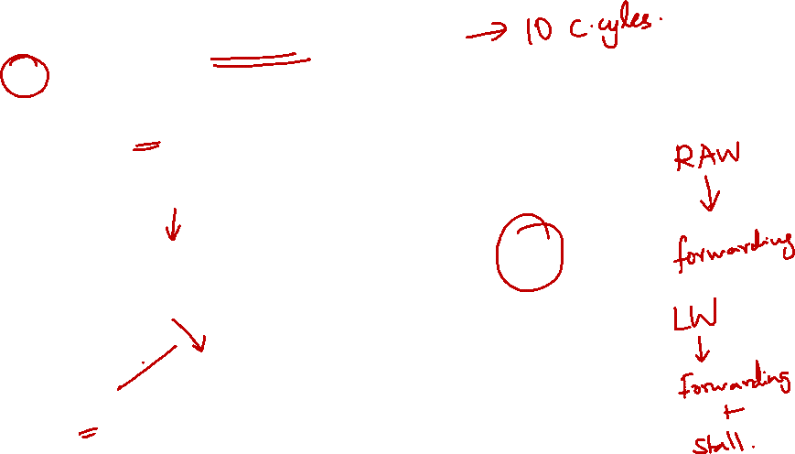
4.3 Exercise #2: With Forwarding
lw $2, 20($3)
and $12, $2, $5
or $13, $6, $2
add $14, $2, $2
sw $15, 100($2)
1 | 2 | 3 | 4 | 5 | 6 | 7 | 8 | 9 | 10 | 11
IF | ID | EX | MEM | WB
lw
and
IF | ID |  | EX | MEM | WB
 | IF |  | ID | EX | MEM | WB
 |  |  | IF | ID | EX | MEM | WB
 |  |  |  | IF | ID | EX | MEM | WB
or
add
sw


Slide 26
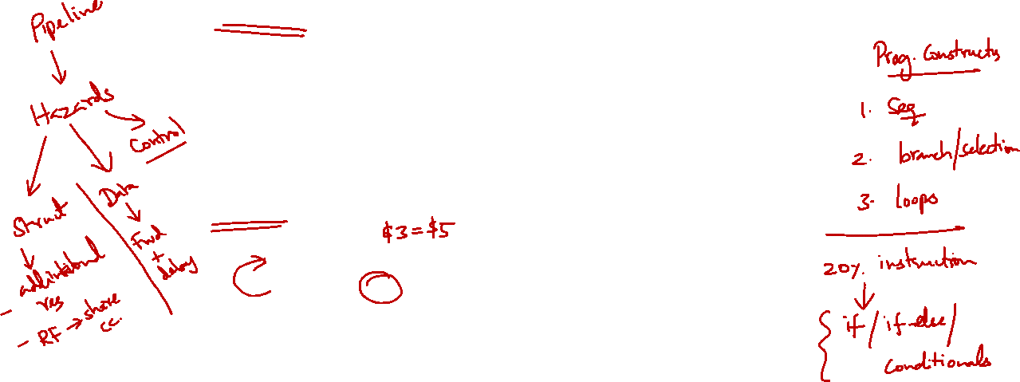
5. Control Dependency
Definition:
An instruction j is control dependent on i if i controls whether or not j executes
Typically i would be a branch instruction
Example:
i1: beq $3, $5, label # branch
i2: add $1, $2, $4 # depends on i1
... ... ...
Effect of incorrect execution:
If i2 is allowed to execute before i1 is determined, register $1 maybe incorrectly changed!

Slide 27
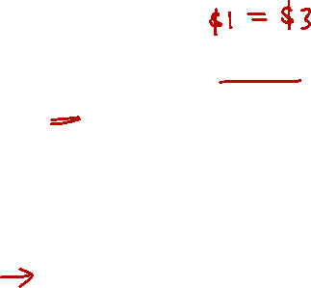
5. Control Dependency: Example
Let us turn to a code fragment with a conditional branch:
40
44
48
52
..
72
beq $1, $3, 7
and $12, $2, $5
or $13, $6, $2
add $14, $2, $2
.........
lw $4, 5($7)
$1 ≠ $3
$1 = $3
How does the code affect a pipeline processor?

Slide 28
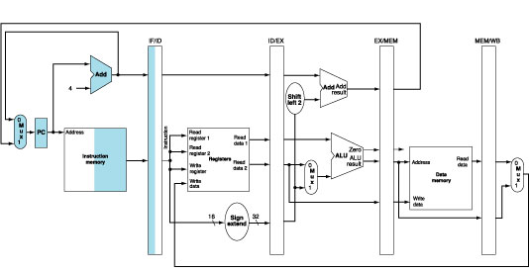

5. Pipeline Execution: IF Stage
Read instruction from memory using the address in PC and put it in IF/ID register
PC address is incremented by 4 and then written back to the PC for next instruction

Slide 29
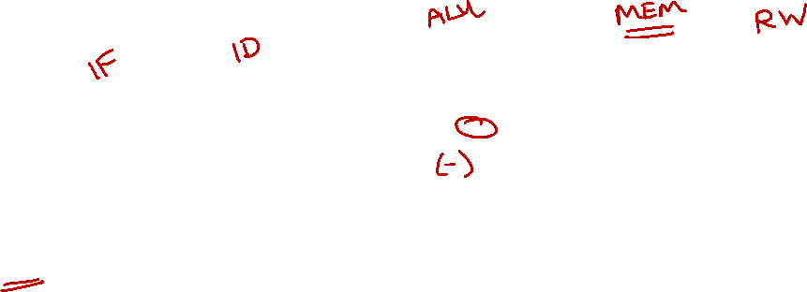
5. Control Dependency: Why?
Decision is made in MEM stage:
Too late!

Slide 30
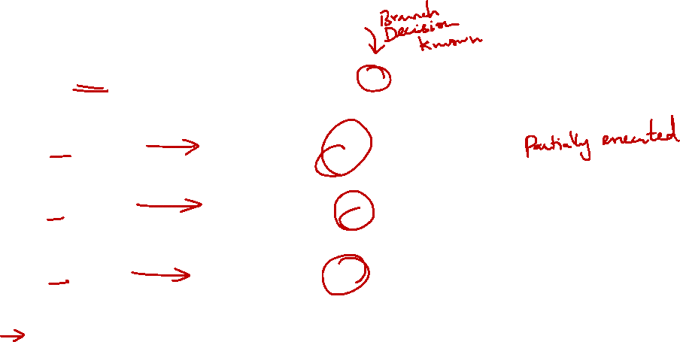
5. Control Dependency: Example
P
r
o
g
r
a
m
T
i
m
e
(
i
n
c
l
o
c
k
c
y
c
l
e
s
)
e
x
e
c
u
t
i
o
n
C
C
1
C
C
2
C
C
3
C
C
4
C
C
5
C
C
6
C
C
7
C
C
8
C
C
9
o
r
d
e
r
Wrong
Execution!
(
i
n
i
n
s
t
r
u
c
t
i
o
n
s
)
4
0
b
e
q
$
1
,
$
3
,
7
I
M
R
e
g
D
M
R
e
g
4
4
a
n
d
$
1
2
,
$
2
,
$
5
I
M
R
e
g
D
M
R
e
g
4
8
o
r
$
1
3
,
$
6
,
$
2
I
M
R
e
g
D
M
R
e
g
5
2
a
d
d
$
1
4
,
$
2
,
$
2
I
M
R
e
g
D
M
R
e
g
7
2
l
w
$
4
,
5
0
(
$
7
)
I
M
R
e
g
D
M
R
e
g

Slide 31
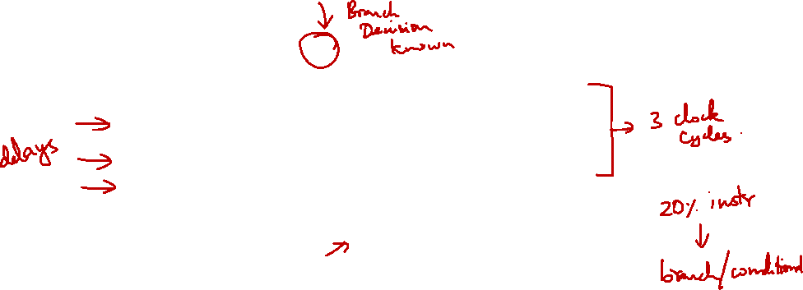
6. Control Hazards: Stall Pipeline?
P
r
o
g
r
a
m
T
i
m
e
(
i
n
c
l
o
c
k
c
y
c
l
e
s
)
e
x
e
c
u
t
i
o
n
C
C
1
C
C
2
C
C
3
C
C
4
C
C
5
C
C
6
C
C
7
C
C
8
C
C
9
o
r
d
e
r
(
i
n
i
n
s
t
r
u
c
t
i
o
n
s
)
4
0
b
e
q
$
1
,
$
3
,
7
I
M
R
e
g
D
M
R
e
g
Bubble
Bubble
Bubble
Bubble
Bubble
Bubble
Bubble
Bubble
Bubble
Bubble
Bubble
Bubble
Bubble
Bubble
Bubble
7
2
l
w
$
4
,
5
0
(
$
7
)
I
M
R
e
g
D
M
R
e
g
Wait until the branch outcome is known and then fetch the correct instructions
➔ Introduces 3 clock cycles delay

Slide 32
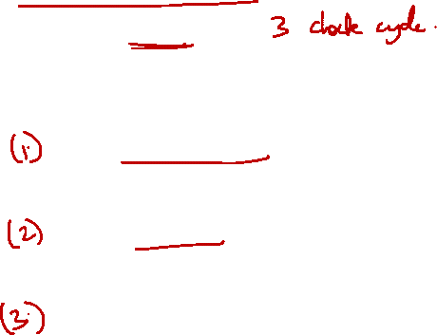
6. Control Hazards: Reducing the Penalty
Branching is very common in code:
A 3-cycle stall penalty is too heavy!
Many techniques invented to reduce the control hazard penalty:
Move branch decision calculation to earlier pipeline stage
Early Branch Resolution
Guess the outcome before it is produced
Branch Prediction
Do something useful while waiting for the outcome
Delayed Branching

Slide 33
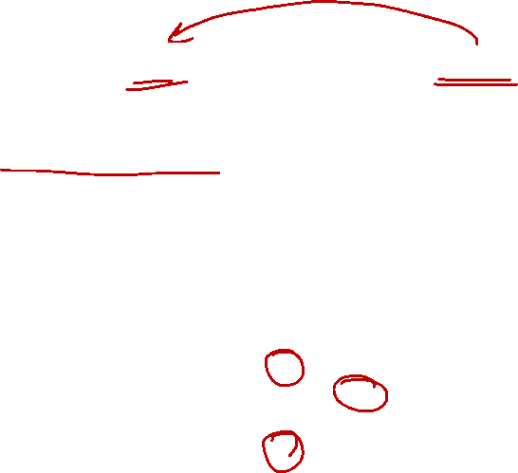
6.1 Reduce Stalls: Early Branch (1/3)
Make decision in ID stage instead of MEM
Move branch target address calculation
Move register comparison ➔ cannot use ALU for register comparison any more
Branch target
address calculation
PC + 4
Target address
Shift
left 2
Add
4
ALUcontrol
Read
register 1
Read
data 1
Read
register 2
To branch
Control logic
Instruction
ALU
Zero
Write
register
Register File
ALU
result
Write
data
Read
data 2
RegWrite
Sign
extend
Register Comparison
16
32

Slide 34
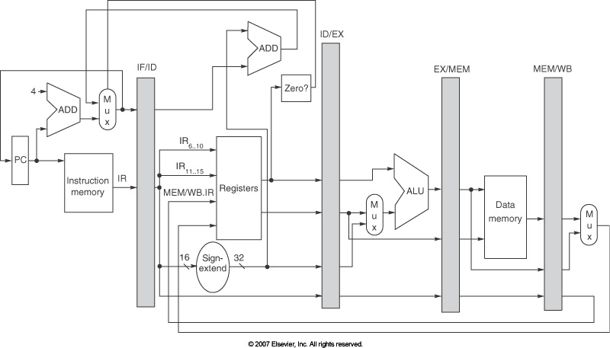
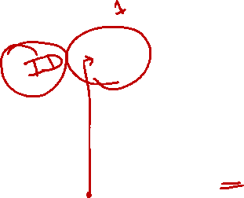
6.1 Reduce Stalls: Early Branch (2/3)
Register comparison
moved to ID stage

Slide 35
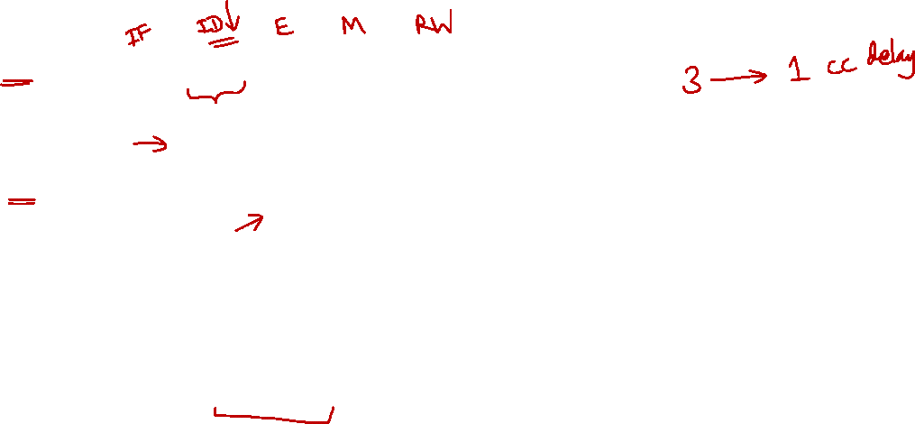
6.1 Reduce Stalls: Early Branch (3/3)
P
r
o
g
r
a
m
T
i
m
e
(
i
n
c
l
o
c
k
c
y
c
l
e
s
)
e
x
e
c
u
t
i
o
n
C
C
1
C
C
2
C
C
3
C
C
4
C
C
5
C
C
6
C
C
7
C
C
8
C
C
9
o
r
d
e
r
(
i
n
i
n
s
t
r
u
c
t
i
o
n
s
)
4
0
b
e
q
$
1
,
$
3
,
7
I
M
R
e
g
D
M
R
e
g
Bubble
Bubble
Bubble
Bubble
Bubble
7
2
l
w
$
4
,
5
0
(
$
7
)
I
M
R
e
g
D
M
R
e
g
Wait until the branch decision is known:
Then fetch the correct instruction
Reduced from 3 to 1 clock cycle delay

Slide 36
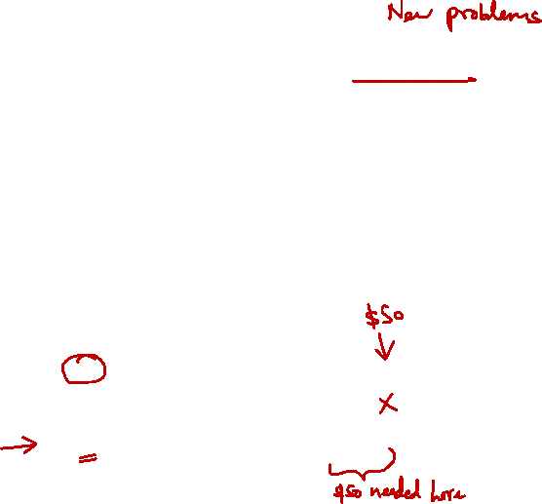
6.1 Early Branch: Problems (1/3)
However, if the register(s) involved in the comparison is produced by preceding instruction:
Further stall is still needed!
T
i
m
e
(
i
n
c
l
o
c
k
c
y
c
l
e
s
)
P
r
o
g
r
a
m
C
C
1
C
C
2
C
C
3
C
C
4
C
C
5
C
C
6
C
C
7
C
C
8
C
C
9
e
x
e
c
u
t
i
o
n
o
r
d
e
r
(
i
n
i
n
s
t
r
u
c
t
i
o
n
s
)
$s0 is needed before it is produced!
add $s0, $s1, $s2
I
M
R
e
g
D
M
R
e
g
beq $s0, $s3, Exit
I
M
R
e
g
D
M
R
e
g
Bubble
I
M
R
e
g
D
M
R
e
g

Slide 37
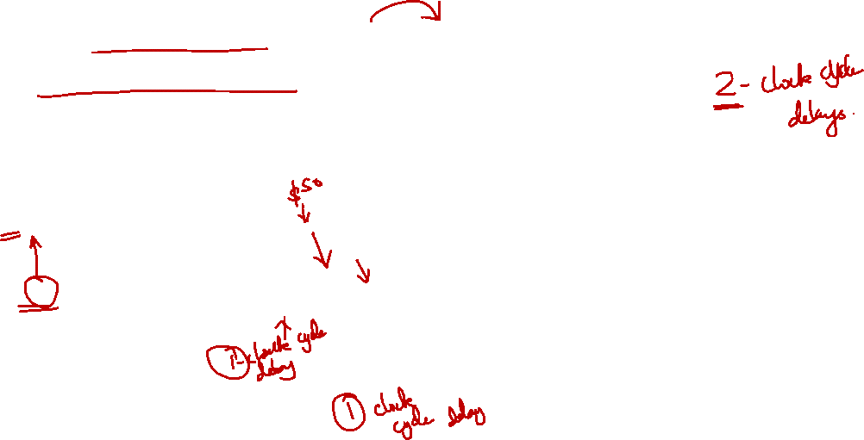
6.1 Early Branch: Problems (2/3)
Solution:
Add forwarding path from ALU to ID stage
One clock cycle delay is still needed
T
i
m
e
(
i
n
c
l
o
c
k
c
y
c
l
e
s
)
P
r
o
g
r
a
m
C
C
1
C
C
2
C
C
3
C
C
4
C
C
5
C
C
6
C
C
7
C
C
8
C
C
9
e
x
e
c
u
t
i
o
n
o
r
d
e
r
(
i
n
i
n
s
t
r
u
c
t
i
o
n
s
)
add $s0, $s1, $s2
I
M
R
e
g
D
M
R
e
g
beq $s0, $s3, Exit
I
M
Bubble
R
e
g
D
M
R
e
g
Bubble
I
M
R
e
g
D
M
R
e
g

Slide 38
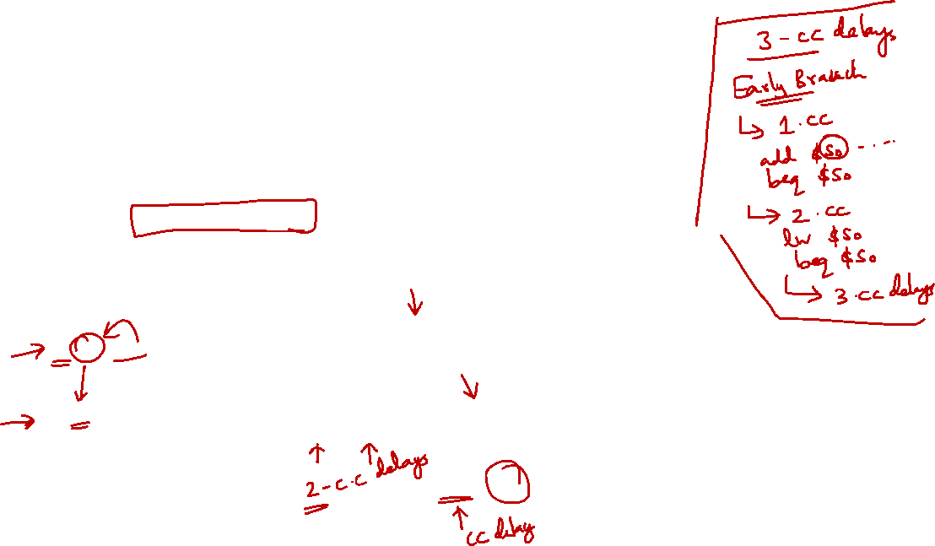
6.1 Early Branch: Problems (3/3)
Problem is worse with load followed by branch
Solution:
MEM to ID forwarding and 2 more stall cycles!
In this case, we ended up with 3 total stall cycles ➔ no improvement!
T
i
m
e
(
i
n
c
l
o
c
k
c
y
c
l
e
s
)
P
r
o
g
r
a
m
C
C
1
C
C
2
C
C
3
C
C
4
C
C
5
C
C
6
C
C
7
C
C
8
C
C
9
e
x
e
c
u
t
i
o
n
o
r
d
e
r
ALU ➔ ID forwarding cannot help!
(
i
n
i
n
s
t
r
u
c
t
i
o
n
s
)
lw $s0, 0($s1)
I
M
R
e
g
D
M
R
e
g
beq $s0, $s3, Exit
I
M
Bubble
Bubble
R
e
g
D
M
R
e
g
Bubble
I
M
R
e
g
D
M
R
e
g

Slide 39
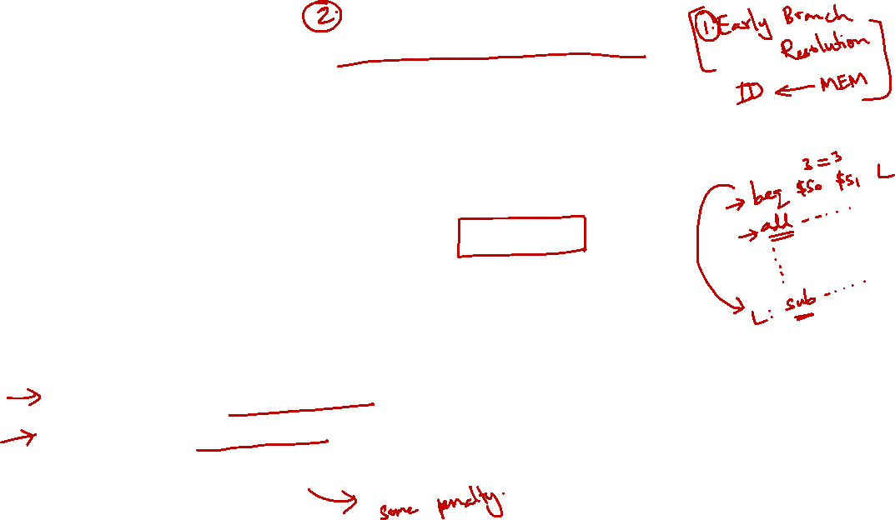
6.2 Reduce Stalls: Branch Prediction
There are many branch prediction schemes
We only cover the simplest in this course ☺
Simple prediction:
All branches are assumed to be not taken
Fetch the successor instruction and start pumping it through the pipeline stages
When the actual branch outcome is known:
Not taken: Guessed correctly ➔ No pipeline stall
Taken: Guessed wrongly ➔ Wrong instructions in the pipeline ➔ Flush successor instruction from the pipeline

Slide 40
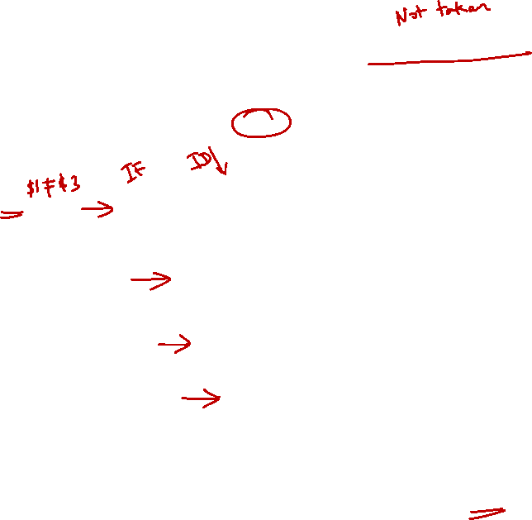
6.2 Branch Prediction: Correct Prediction
T
i
m
e
(
i
n
c
l
o
c
k
c
y
c
l
e
s
)
P
r
o
g
r
a
m
C
C
1
C
C
2
C
C
3
C
C
4
C
C
5
C
C
6
C
C
7
C
C
8
C
C
9
e
x
e
c
u
t
i
o
n
o
r
d
e
r
(
i
n
i
n
s
t
r
u
c
t
i
o
n
s
)
4
0
b
e
q
$
1
,
$
3
,
7
I
M
R
e
g
D
M
R
e
g
4
4
a
n
d
$
1
2
,
$
2
,
$
5
I
M
R
e
g
D
M
R
e
g
4
8
o
r
$
1
3
,
$
6
,
$
2
I
M
R
e
g
D
M
R
e
g
5
2
a
d
d
$
1
4
,
$
2
,
$
2
Branch is known to be not taken in cycle 3
➔ no stall needed!

Slide 41
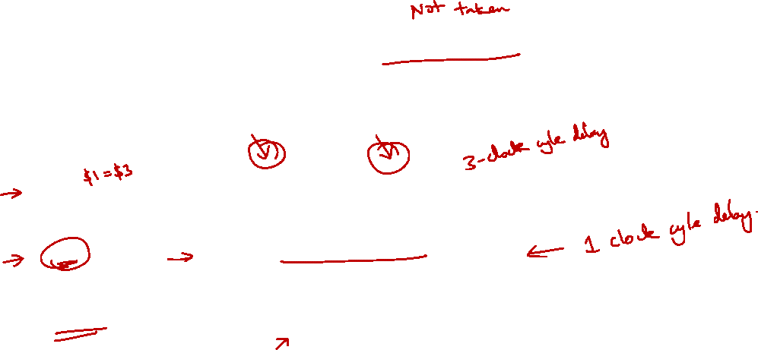
6.2 Branch Prediction: Wrong Prediction
T
i
m
e
(
i
n
c
l
o
c
k
c
y
c
l
e
s
)
P
r
o
g
r
a
m
C
C
1
C
C
2
C
C
3
C
C
4
C
C
5
C
C
6
C
C
7
C
C
8
C
C
9
e
x
e
c
u
t
i
o
n
o
r
d
e
r
(
i
n
i
n
s
t
r
u
c
t
i
o
n
s
)
4
0
b
e
q
$
1
,
$
3
,
7
I
M
R
e
g
D
M
R
e
g
4
4
a
n
d
$
1
2
,
$
2
,
$
5
I
M
Bubble
Bubble
Bubble
Bubble
7
2
l
w
$
4
,
5
0
(
$
7
)
I
M
R
e
g
D
M
R
e
g
Branch is known to be taken in cycle 3
"and" instruction should not be executed
➔ Flushed from pipeline

Slide 42
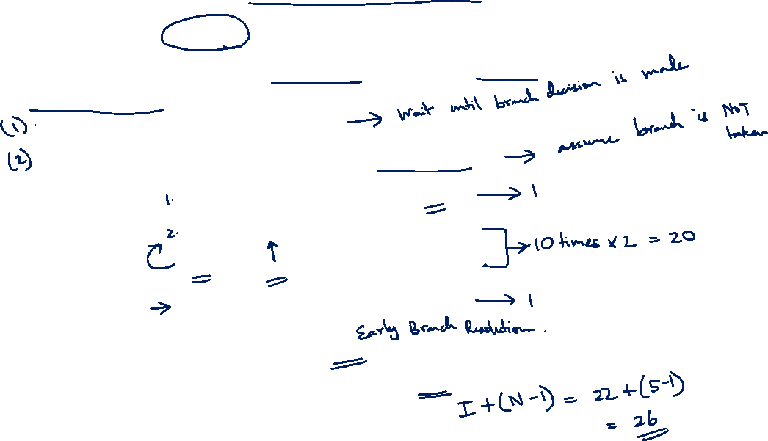
6.2 Exercise #3: Branch Prediction
How many cycles will it take to execute the following code on a 5-stage pipeline with forwarding and …
without branch prediction?
with branch prediction (predict not taken)?
addi $s0, $zero, 10
Loop: addi $s0, $s0, -1
bne $s0, $zero, Loop
sub $t0, $t1, $t2
Decision making moved to ID stage
Total instructions = 1 + 10×2 + 1 = 22
Ideal pipeline = 4 + 22 = 26 cycles

Slide 43
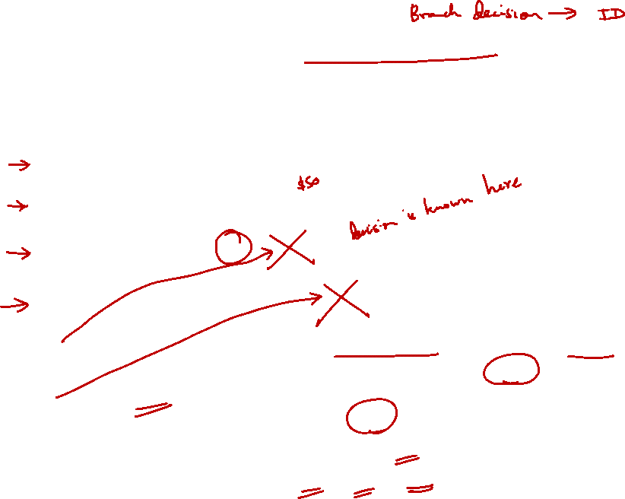
6.2 Exercise #3: Without Branch Prediction
1 | 2 | 3 | 4 | 5 | 6 | 7 | 8 | 9 | 10 | 11
IF | ID | EX | MEM | WB
 | IF | ID | EX | MEM | WB
 |  | IF |  | ID | EX | MEM | WB
 |  |  |  |  | IF | ID | EX | MEM | WB
addi¹
addi²
bne
addi²
Data dependency between (addi $s0, $s0, -1) and bne incurs 1 cycle of delay. There are 10 iterations, hence 10 cycles of delay.
Every bne incurs a cycle of delay to execute the next instruction. There are 10 iterations, hence 10 cycles of delay.
Total number of cycles of delay = 20.
Total execution cycles = 26 + 20 = 46 cycles.


Slide 44
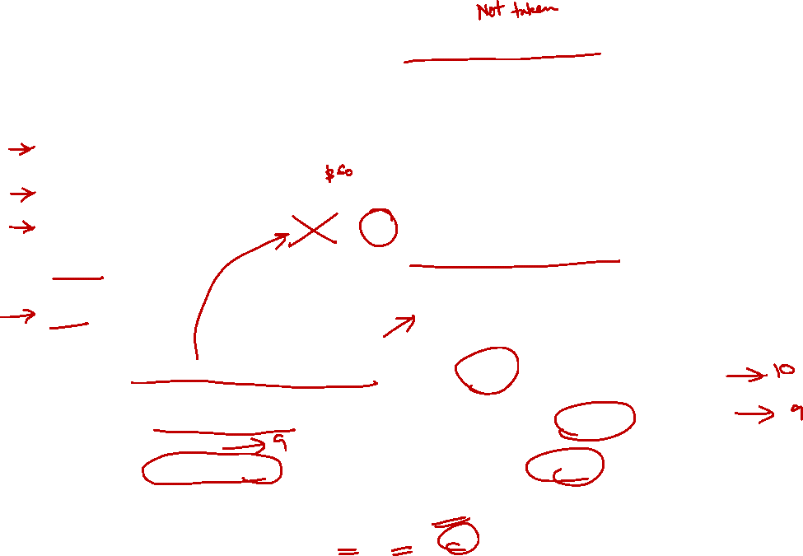
6.2 Exercise #3: With Branch Prediction
1 | 2 | 3 | 4 | 5 | 6 | 7 | 8 | 9 | 10 | 11
IF | ID | EX | MEM | WB
 | IF | ID | EX | MEM | WB
 |  | IF |  | ID | EX | MEM | WB
 |  |  |  | IF
 |  |  |  |  | IF | ID | EX | MEM | WB
addi¹
addi²
bne
sub
addi²
Predict not taken.
The data dependency remains, hence 10 cycles of delay for 10 iterations.
In the first 9 iterations, the branch prediction is wrong, hence 1 cycle of delay.
In the last iteration, the branch prediction is correct, hence saving 1 cycle of delay.
Total number of cycles of delay = 19.
Total execution cycles = 26 + 19 = 45 cycles.


Slide 45
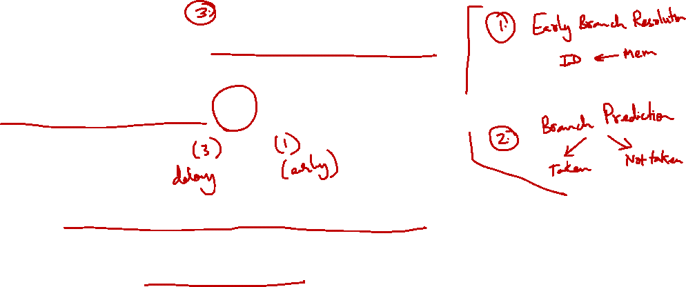
6.3 Reduce Stalls: Delayed Branch
Observation:
Branch outcome takes X number of cycles to be known
X cycles stall
Idea:
Move non-control dependent instructions into the X slots following a branch
Known as the branch-delay slot
These instructions are executed regardless of the branch outcome
In our MIPS processor:
Branch-Delay slot = 1 (with the early branch)

Slide 46
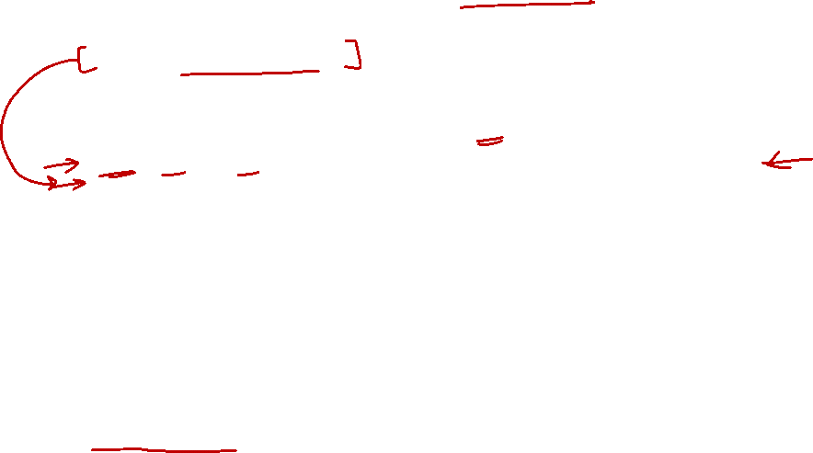
6.3 Delayed Branch: Example
Non-delayed branch
or $8, $9, $10
add $1, $2, $3
sub $4, $5, $6
beq $1, $4, Exit
xor $10, $1, $11
Exit:
Delayed branch
add $1, $2, $3
sub $4, $5, $6
beq $1, $4, Exit
or $8, $9, $10
xor $10, $1, $11
Exit:
The "or" instruction is moved into the delayed slot:
Get executed regardless of the branch outcome
➔ Same behavior as the original code!

Slide 47

6.3 Delayed Branch: Observation
Best case scenario
There is an instruction preceding the branch which can be moved into the delayed slot
Program correctness must be preserved!
Worst case scenario
Such instruction cannot be found
➔ Add a no-op (nop) instruction in the branch-delay slot
Re-ordering instructions is a common method of program optimization
Compiler must be smart enough to do this
Usually can find such an instruction at least 50% of the time

Slide 48
7. Multiple Issue Processors (1/2)
For reading only
Multiple Issue processors
Multiple instructions in every pipeline stage
4 washer, 4 dryer…
Static multiple issue:
EPIC (Explicitly Parallel Instruction Computer) or VLIW (Very Long Instruction Word), e.g. IA64
Compiler specifies the set of instructions that execute together in a given clock cycle
Simple hardware, complex compiler
Dynamic multiple issue:
Superscalar processor: Dominant design of modern processors
Hardware decides which instructions to execute together
Complex hardware, simpler compiler
Notes:
Wikipedia:
A superscalar processor is a CPU that implements a form of parallelism called instruction-level parallelism within a single processor. In contrast to a scalar processor that can execute at most one single instruction per clock cycle, a superscalar processor can execute more than one instruction during a clock cycle by simultaneously dispatching multiple instructions to different execution units on the processor. It therefore allows for more throughput (the number of instructions that can be executed in a unit of time) than would otherwise be possible at a given clock rate. Each execution unit is not a separate processor (or a core if the processor is a multi-core processor), but an execution resource within a single CPU such as an arithmetic logic unit.

Slide 49
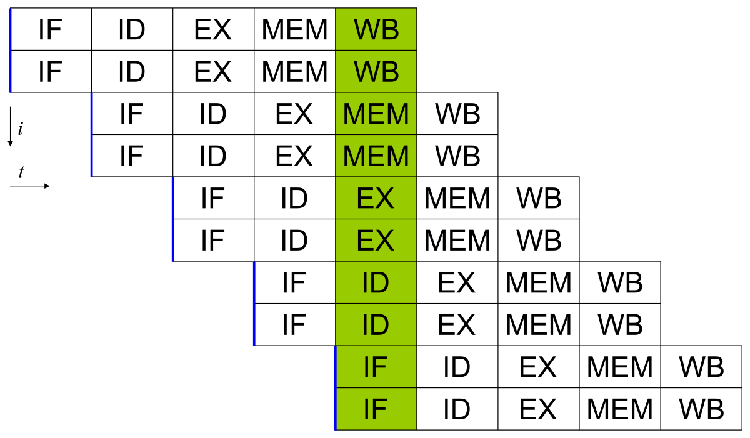
7. Multiple Issue Processors (2/2)
For reading only
A 2-wide superscalar pipeline:
By fetching and dispatching two instructions at a time, a maximum of two instructions per cycle can be completed.

Slide 50
Summary
Pipelining is a fundamental concept in computer systems
Multiple instructions in flight
Limited by length of the longest stage
Hazards create trouble by stalling pipeline
Pentium 4 has 22 pipeline stages!

Slide 51
Reading
3rd edition
Sections 6.1 – 6.3
Sections 6.4 – 6.6 (data hazards and control hazards in details; read for interest; not in syllabus)
4th edition
Sections 4.5 – 4.6
Sections 4.7 – 4.8 (data hazards and control hazards in details; read for interest; not in syllabus)

Slide 52
End of File

